Slide 1
What is a Data Scientist and How Do I Become One?
April 1st, 2019
Brad Llewellyn
Data Analytics Architect
Microsoft

Slide 2
The views expressed during this presentation may not represent the official views of Microsoft or the FastTrack for Azure team.

Slide 3





MCSE: Data Management and Analytics
MCSE: Cloud Platform and Infrastructure
MCSA: Machine Learning
MCSA: SQL 2016 BI Development
MCA: SQL 2016 Database Development
MCSA: SQL Server 2012/2014
MCSA: Cloud Platform
M.S. Statistics: University of South Carolina
Analytics Consultant – 6 Years
Microsoft – 1 Month
@BreakingBI
https://www.linkedin.com/in/bradllewellyn
http://breaking-bi.blogspot.com
Llewellyn.wb@gmail.com
Brad Llewellyn
Data Analytics Architect
Microsoft
Organizer – Charlotte BI Group – http://charbigroup.com
Member and Speaker – PASS – http://www.pass.org

Slide 4



https://www.pass.org

Slide 5
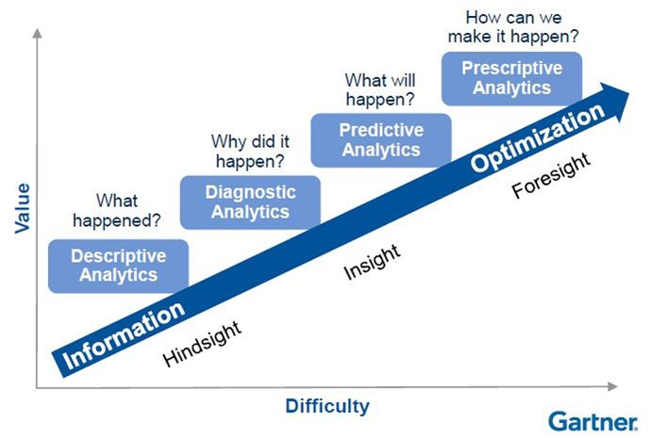
What is Data Science?
Advanced Analytics

Slide 6




Agenda
Job Search, Interview and Career Advice
Statistician, Advanced Data Analyst
Business Intelligence Developer
Big Data Developer

Slide 7
Job Search, Interview and Career Advice
Landing The Dream Job

Slide 8



Self-Paced Learning
Certifications
Build Your Own Project/Blog
FREE!!!
Webinars and Online Courses
FREE!!!

Slide 9
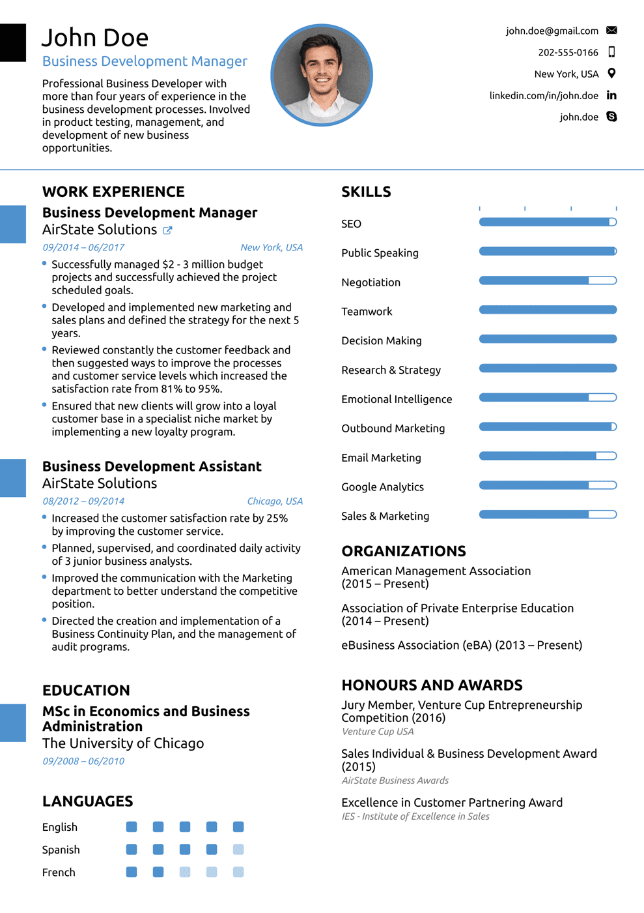
Creating a Resume
Emphasize Certifications, Blogs and Training
Use Buzzwords
SQL, R, Python, Hadoop, etc.
Use Professional Contact Information

Slide 10

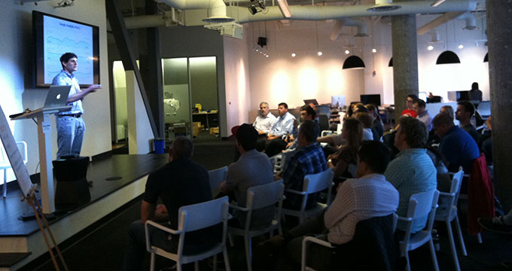

Networking
LinkedIn
https://www.linkedin.com
User Groups and Meetups
https://www.meetup.com
https://www.pass.org
Recruiters and Thought Leaders

Slide 11


Interviewing
Prepare! Prepare! Prepare!
Bring Your Relevant Projects
Be Conversational and Interested
Stay Positive!

Slide 12

Advancing Your Career
Focus on Training and Certifications
Ask Your Manager or Advisor for Guidance
1-on-1’s
Stay Positive!

Slide 13
Statistician, Advanced Data Analyst
Behold the Power of Mathematics

Slide 14
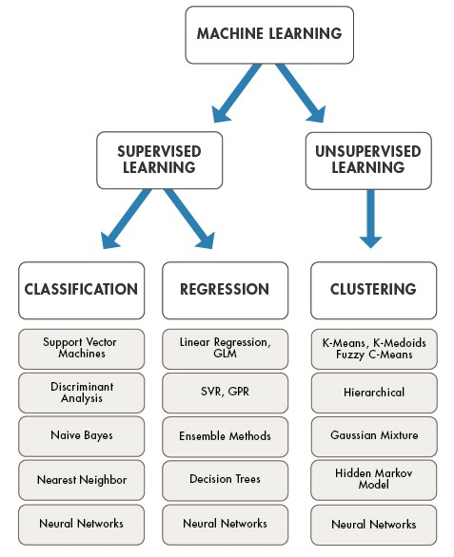
What Do They Do?
Focus on Individual Analyses
Day-to-Day Tasks
Cleaning Data
Evaluating Models
Presenting Results
Junior Titles
Data Scientist*
Data Analyst*
Statistical Analyst
Statistical Modeler

Slide 15



What are the Job Requirements?
Acceptable Backgrounds
Mathematics
Statistics
Languages Used
Python
R
SAS

Slide 16
Where Can I Find Free Training?
Python
https://courses.edx.org/courses/course-v1:UCSanDiegoX+DSE200x+3T2018/course/
R
https://www.rstudio.com/resources/webinars/
SAS
https://www.sas.com/en_us/webinars.html

Slide 17
How Should I Build My Own Project?
Kaggle
https://www.kaggle.com/competitions
Python and R are Free
https://www.anaconda.com/download/
https://rstuio.com/products/rstudio/download/
SAS has Free Trials
https://www.sas.com/en_us/trials.html
Python is the most popular at this point.
Try them all if you want.

Slide 18
Where Can I Find Good Certifications?
Python - $499 Per Course
https://www.edureka.co/python
R - $49 Per Month
https://www.coursera.org/specializations/jhu-data-science
SAS - $180 Per Certification
https://www.sas.com/en_us/certification.html
Microsoft – FREE!!!
https://academy.microsoft.com/en-us/professional-program/tracks/data-science/

Slide 19
Business Intelligence Developer
Empowering the Business World

Slide 20
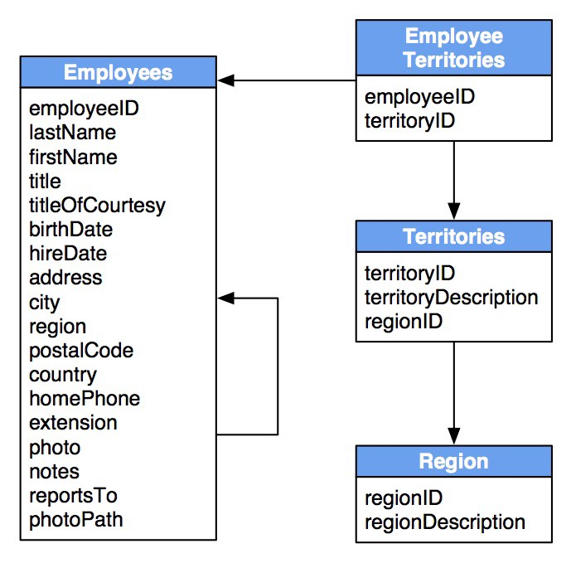
What Do They Do?
Focus on Building Relational Structures
Day-to-Day Tasks
Creating Pipelines
Creating Databases
Creating Reports
Junior Titles
Report Developer
Database Developer
Data Engineer*
Data Modeler*

Slide 21



What are the Job Requirements?
Acceptable Backgrounds
Anything Technical
Tools Used
SQL Server
Power BI
Azure

Slide 22
Where Can I Find Free Training?
Microsoft
https://mva.microsoft.com/
http://pragmaticworks.com/Training/Courses#type=Free
https://www.edx.org/school/microsoft

Slide 23
How Should I Build My Own Project?
Power BI Desktop is Free
https://powerbi.microsoft.com/en-us/desktop
Download Sample Data
https://powerbi.microsoft.com/en-us/documentation/powerbi-sample-datasets/
Build Some Data Models and Reports
SQL Server Developer Edition is Free
https://www.microsoft.com/en-us/sql-server/sql-server-downloads
Azure has a Free Trial with Sample Data Included
https://azure.microsoft.com

Slide 24
Where Can I Find Good Certifications?
SQL Server - $165 Per Exam
https://www.microsoft.com/en-us/learning/mcsa-sql2016-business-intelligence-certification.aspx
https://www.microsoft.com/en-us/learning/mcsa-sql2016-database-administration-certification.aspx
https://www.microsoft.com/en-us/learning/mcsa-sql2016-database-development-certification.aspx
Power BI - $165 Per Exam
https://www.microsoft.com/en-us/learning/mcsa-bi-reporting.aspx

Slide 25
Big Data Developer
Pushing the Boundaries of Technology

Slide 26
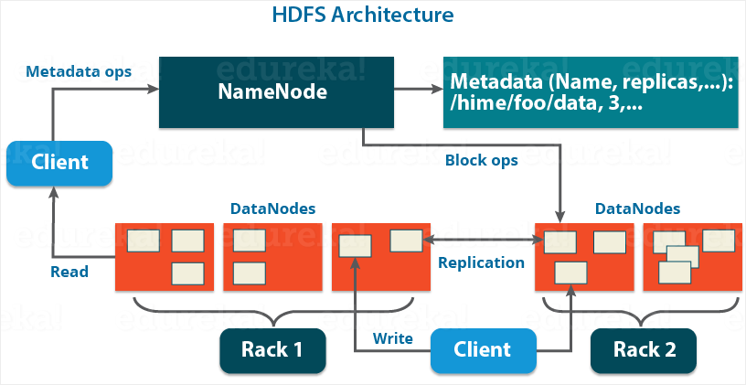
What Do They Do?
Focus on Building Distributed Structures
Day-to-Day Tasks
Creating Pipelines
Creating “Databases”
Junior Titles
Data Engineer*
Big Data Engineer
Hadoop Developer
Spark Developer

Slide 27

What are the Job Requirements?
Acceptable Backgrounds
Computer Science
Tools Used
Hadoop
Python
Azure

Slide 28
Where Can I Find Free Training?
Hadoop
https://databricks.com/resources/type/webinars
https://hortonworks.com/webinars/
https://www.cloudera.com/search.html?i=1;q1=Webinars;x1=doctype
Python
Search for “PySpark”
Azure
https://mva.microsoft.com/
http://pragmaticworks.com/Training/Courses#type=Free
https://www.edx.org/school/microsoft

Slide 29
How Should I Build My Own Project?
Hadoop is Open-Source (but not simple)
https://hadoop.apache.org
Python is Free
https://www.anaconda.com/download/
Kaggle
https://www.kaggle.com/competitions
Azure has a Free Trial with Sample Data Included
https://azure.microsoft.com

Slide 30
Where Can I Find Good Certifications?
Hadoop - $100/$295 Per Certification
https://hortonworks.com/services/training/certification/
https://www.cloudera.com/more/training/certification.html
Python - $404 Per Course
https://www.edureka.co/pyspark-certification-training
Azure - $165 Per Exam
https://www.microsoft.com/en-us/learning/mcsa-data-engineering-with-azure.aspx

Slide 31
Review
Statistician, Advanced Data Analyst
Builds Predictive Models
High Barrier to Entry Outside of Math/Stats
Demand is High, May Decline in 5-10 Years
Business Intelligence Developer
Builds Relational Structures
Low Barrier to Entry
Demand is High, Likely to Remain Stable
Big Data Developer
Builds Distributed Structures
High Barrier to Entry
Demand is Low, Likely to Increase

Slide 32
So, Where Do I Start?
Step 1: Choose a Role.
Step 2: Follow the Provided Links to Find a Relevant Certification
Step 3: Prepare for the Certification with Books, Webinars and Build-Your-Own Projects.
Step 4: Get Certified!
Most importantly, while you’re doing this, network with as many recruiters, managers and thought leaders and possible via User Groups, Meetups, LinkedIn and other social/technical events.

Slide 33

Brad Llewellyn
Data Analytics Architect
Microsoft
@BreakingBI
https://www.linkedin.com/in/bradllewellyn
http://breaking-bi.blogspot.com
Llewellyn.wb@gmail.com

